Slide 1
Chapter 9
Internet Control Message Protocol Version 4 (ICMPv4)

Slide 2
9-1 INTRODUCTION
The IP protocol has no error-reporting or error correcting mechanism. What happens if something goes wrong? What happens if a router must discard a datagram because it cannot find a router to the final destination, or because the time-to-live field has a zero value? These are examples of situations where an error has occurred and the IP protocol has no built-in mechanism to notify the original host.
TCP/IP Protocol Suite

Slide 3
Topics Discussed in the Section
The position of ICMP in the TCP/IP suite
Encapsulation of ICMP Packets

Slide 4
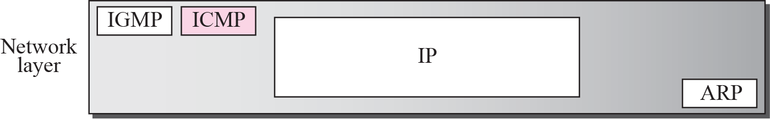
Figure 9.1 Position of ICMP in the network layer
TCP/IP Protocol Suite

Slide 5
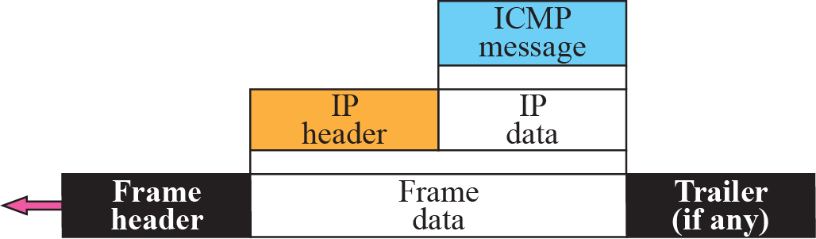
Figure 9.2 ICMP encapsulation
TCP/IP Protocol Suite

Slide 6
9-2 MESSAGES
ICMP messages are divided into two broad categories: error-reporting messages and query messages.
The error-reporting messages report problems that a router or a host (destination) may encounter when it processes an IP packet.
The query messages, which occur in pairs, help a host or a network manager get specific information from a router or another host. Also, hosts can discover and learn about routers on their network and routers can help a node redirect its messages.

Slide 7
Topics Discussed in the Section
Message Format
Error Reporting Messages
Query Messages
Checksum
TCP/IP Protocol Suite

Slide 8
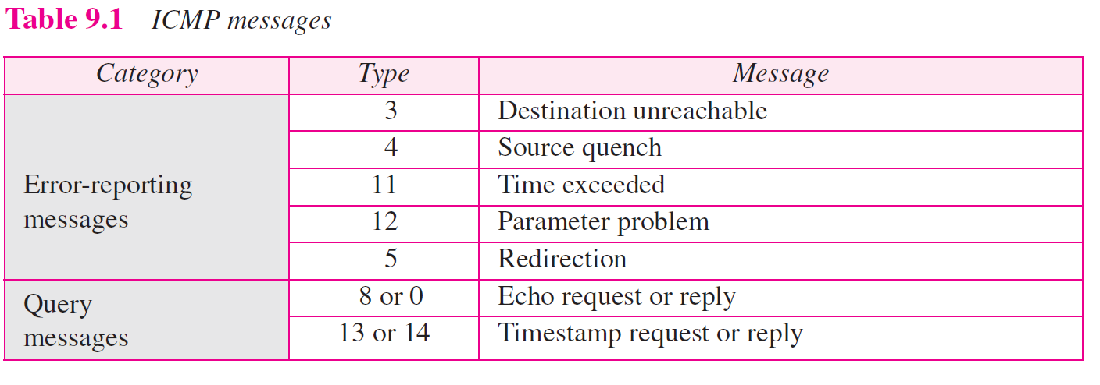

Slide 9
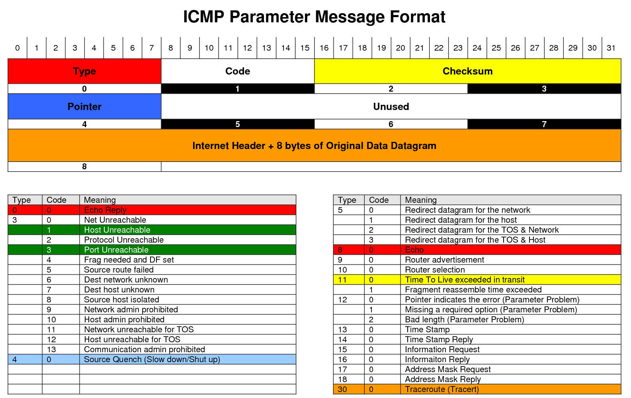
TCP/IP Protocol Suite

Slide 10
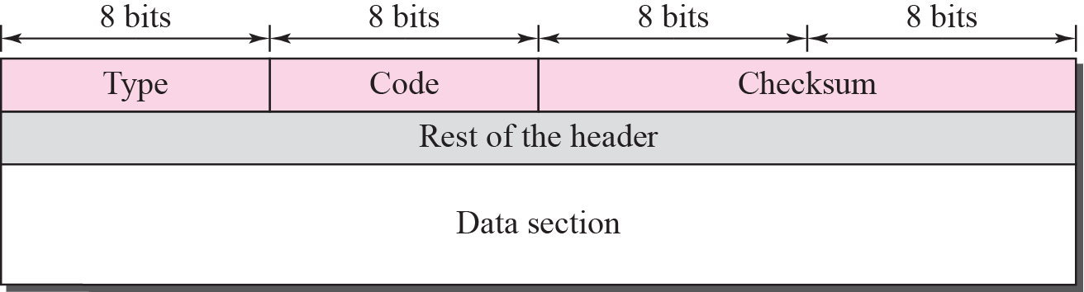
Figure 9.3 General format of ICMP messages
TCP/IP Protocol Suite

Slide 11
ICMP always reports error messages to the original source.
TCP/IP Protocol Suite

Slide 12
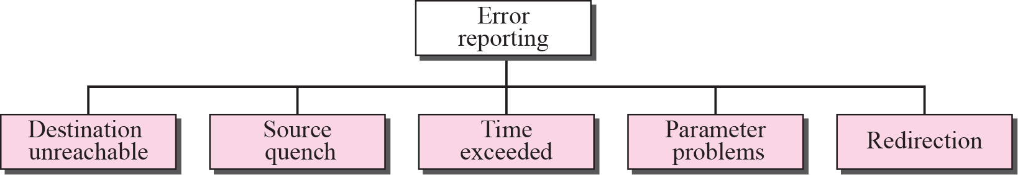
Figure 9.4 Error-reporting messages
TCP/IP Protocol Suite

Slide 13
Important Points:
No ICMP error messages are generated for:
Datagram carrying a ICMP error message.
Fragmented datagram that is not the first fragment.
Multicast address
Datagram having special address such as loopback or 0.0.0.0
TCP/IP Protocol Suite

Slide 14
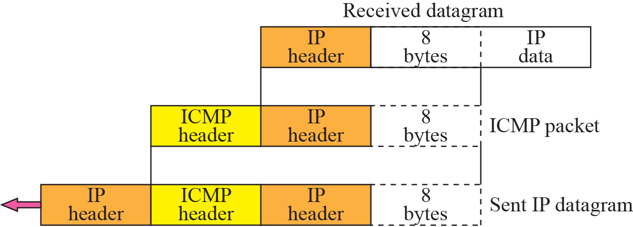
Figure 9.5 Contents of data field for the error message
TCP & UDP Header
TCP/IP Protocol Suite

Slide 15
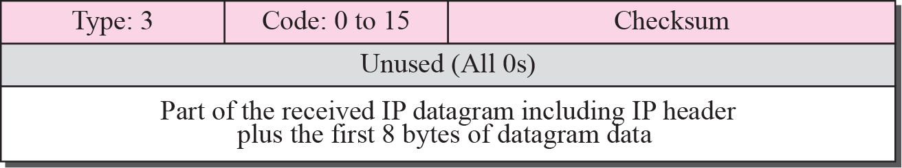
Figure 9.6 Destination-unreachable format
TCP/IP Protocol Suite

Slide 16
Destination-unreachable messages with codes 2 or 3 can be created only by the
destination host.
Other destination-unreachable messages can be created only by routers.
TCP/IP Protocol Suite

Slide 17
Source Quench
There is no flow-control or congestion-control mechanism in the IP protocol.
TCP/IP Protocol Suite

Slide 18
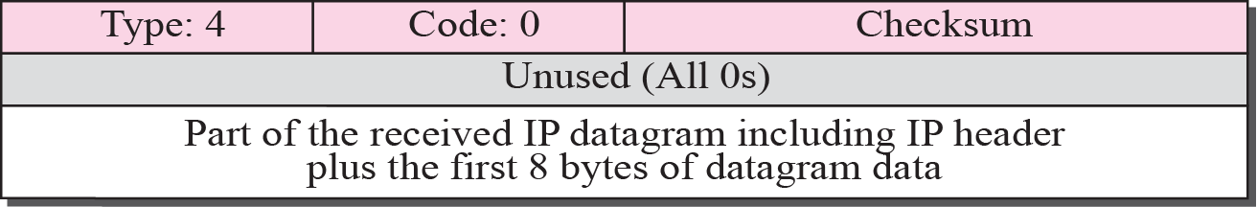
Figure 9.7 Source-quench format
TCP/IP Protocol Suite

Slide 19
A source-quench message informs the source that a datagram has been discarded due to congestion in
a router or the destination host.
The source must slow down the sending of datagrams until the congestion is relieved.
TCP/IP Protocol Suite

Slide 20
One source-quench message is sent for each datagram that is discarded due
to congestion.
TCP/IP Protocol Suite

Slide 21
Time Exceeded:
Whenever a router decrements a datagram with a time-to-live value to zero, it discards the datagram and
sends a time-exceeded message to the original source.
TCP/IP Protocol Suite

Slide 22
When the final destination does not receive all of the fragments in a
set time, it discards the received fragments and sends a
time-exceeded message to
the original source.
TCP/IP Protocol Suite

Slide 23
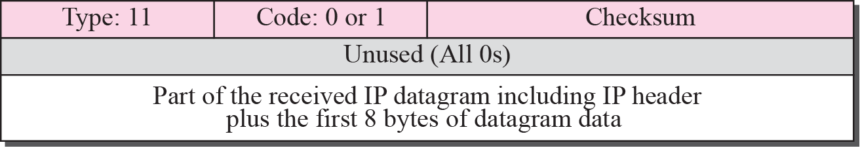
Figure 9.8 Time-exceeded message format
TCP/IP Protocol Suite

Slide 24
In a time-exceeded message, code 0 is used only by routers to show that the value of the time-to-live field is zero.
Code 1 is used only by the destination host to show that not all of
the fragments have arrived
within a set time.
TCP/IP Protocol Suite

Slide 25
Parameter Problem
A parameter-problem message can be created by a router or the destination host.
TCP/IP Protocol Suite

Slide 26
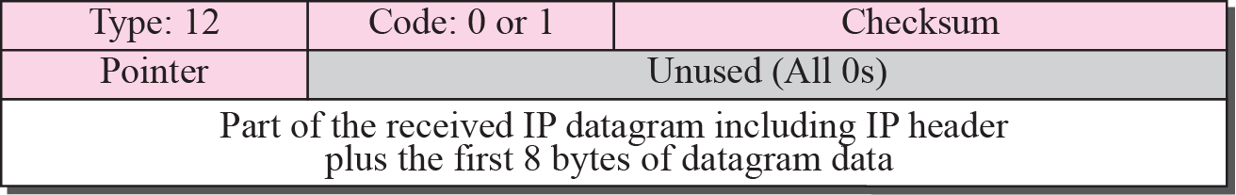
Figure 9.9 Parameter-problem message format
TCP/IP Protocol Suite

Slide 27
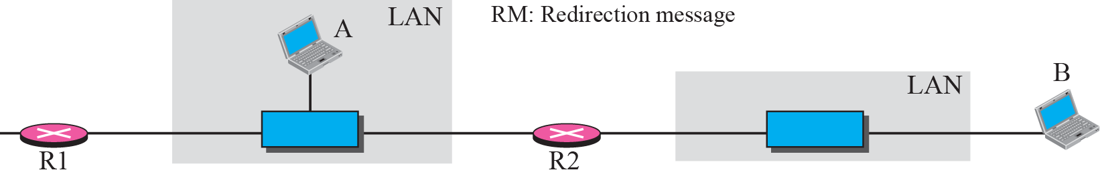
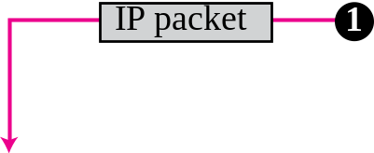

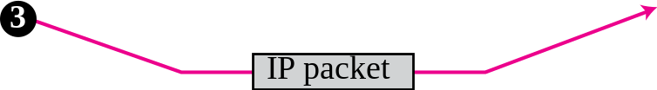
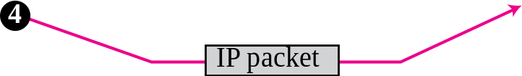
Figure 9.10 Redirection concept
TCP/IP Protocol Suite

Slide 28
A host usually starts with a small routing table that is gradually augmented and updated.
One of the tools to accomplish this
is the redirection message.
TCP/IP Protocol Suite

Slide 29
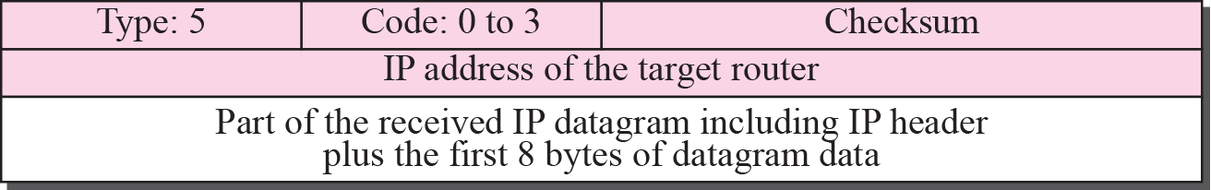
Figure 9.11 Redirection message format
TCP/IP Protocol Suite

Slide 30
A redirection message is sent from a router to a host on the same local network.
TCP/IP Protocol Suite

Slide 31
QUERY MESSAGE:
Echo Request and Reply
An echo-request message can be sent by a host or router.
An echo-reply message is sent
by the host or router that receives
an echo-request message.
TCP/IP Protocol Suite

Slide 32
Echo-request and echo-reply messages can be used by network managers to check the operation of the IP protocol.
TCP/IP Protocol Suite

Slide 33
Echo-request and echo-reply messages can test the reachability of a host.
This is usually
done by invoking the ping command.
TCP/IP Protocol Suite

Slide 34
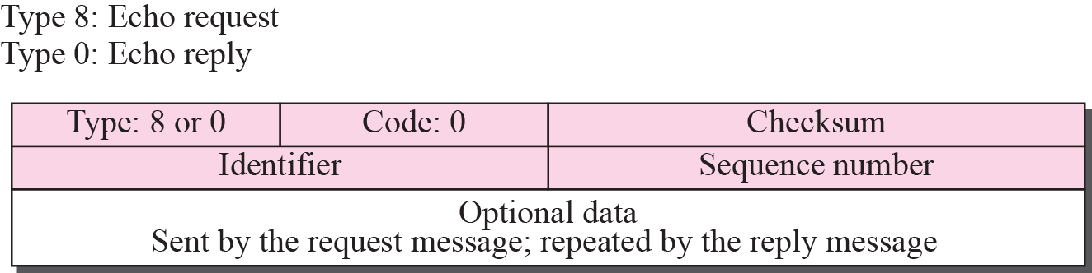
Figure 9.12 Echo-request and echo-reply message
TCP/IP Protocol Suite

Slide 35
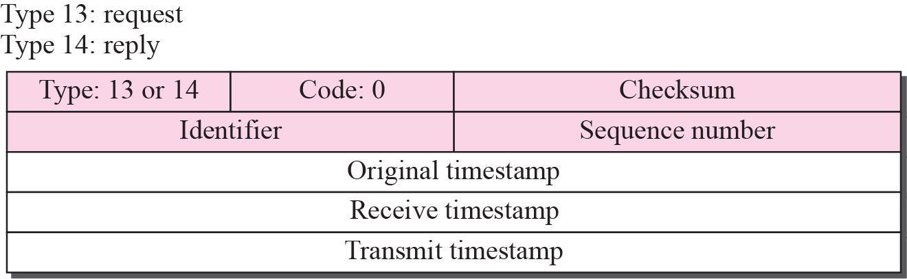
Figure 9.13 Timestamp-request and timestamp-reply message format
TCP/IP Protocol Suite

Slide 36
Timestamp-request and Reply message
Timestamp-request and timestamp-reply messages can be used to calculate the
round-trip time between a source and a destination machine even if their
clocks are not synchronized.
TCP/IP Protocol Suite

Slide 37
The timestamp-request and timestamp-reply messages can be used to synchronize two clocks in two
machines if the exact one-way
time duration is known.
TCP/IP Protocol Suite

